Slide 1
Random Forest

Slide 2
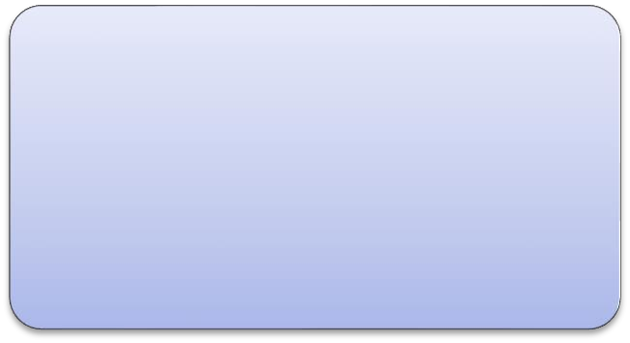
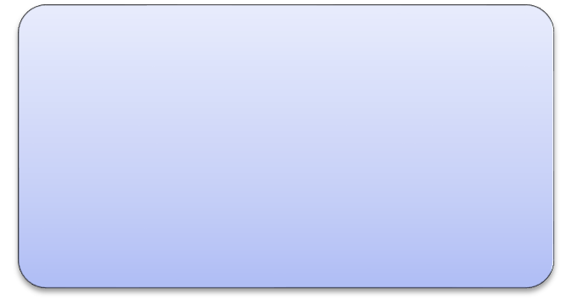
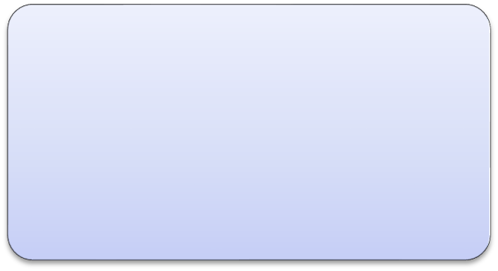


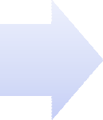
Basic steps - Classification algorithms
Profiling
Differentiation
Classification
2

Slide 3
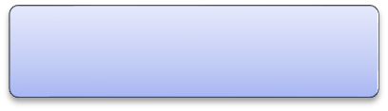
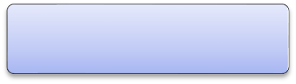
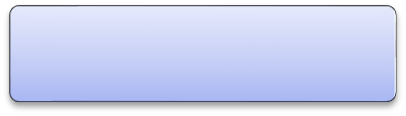
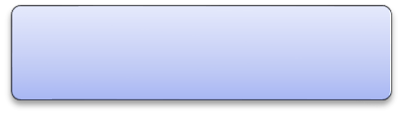
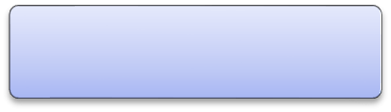
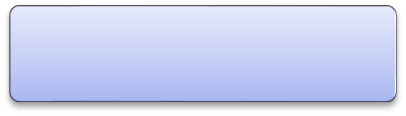









Should I invest in a company – ask the experts
Employee of XYZ
Financial Advisor of XYZ
Stock Market Trader
Employee of a competitor
Market Research team
Social Media Expert
Knows internal
functionality
perspective on companies
vs competition
observed company’s stock
price over past 3 years
internal functionality of the
competitor firms
analyzes the customer
preference of XYZ’s product
understand product
positioning
lacks a view on internal policies
knows seasonality trends and market performance
lacks a sight of company in focus and the external factors
unaware of the changes XYZ will bring
Changes in customer sentiment over time
insider information
lacks a broader perspective on competitors
has been right 75% times.
has been right 70% times.
has been right 60% of times.
have been right 75% of times.
unaware of details beyond digital marketing
has been right 70% times.
has been right 65% of times.

Slide 4
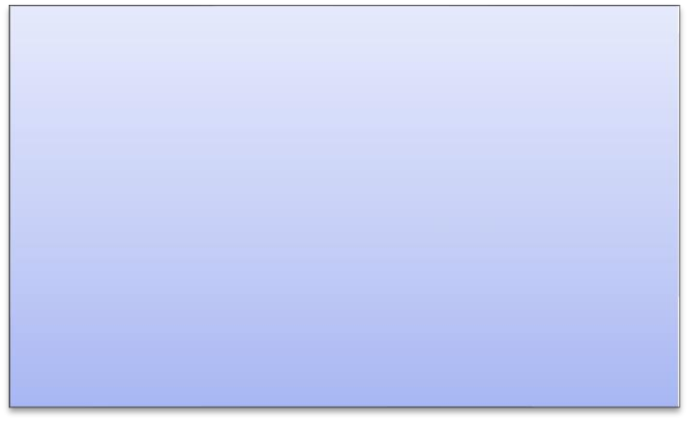
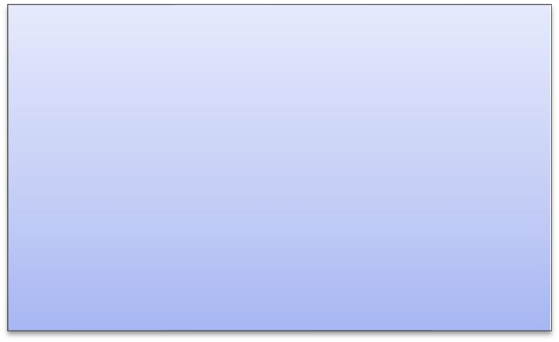
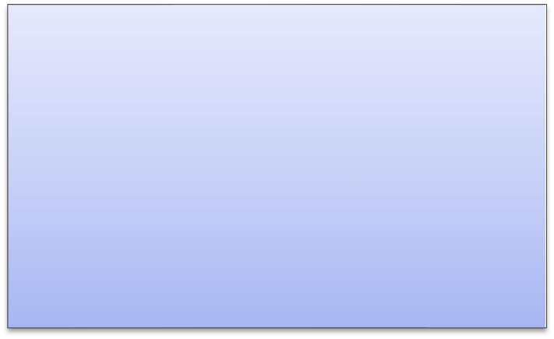
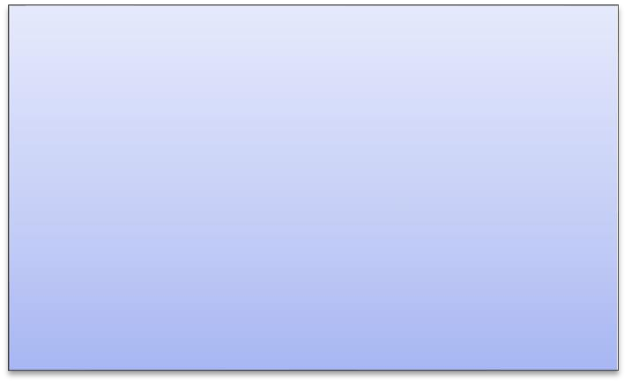
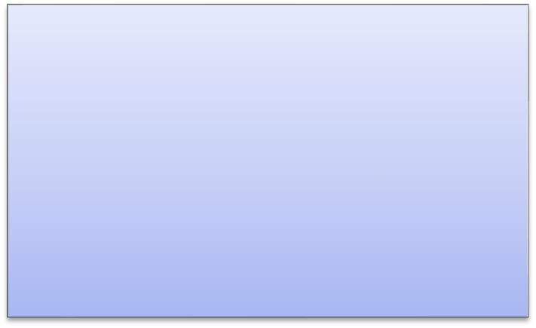
Scenario1 - Combine all the info – informed decision
assuming all the predictions are independent of each other
all the 6 experts/teams verify that it’s a good decision
Assumption – decisions are not correlated
Each person thinks from a different perspective to take the decision and not influenced by the other
combined accuracy rate improves when we take voting principle (complementing principle)

Slide 5
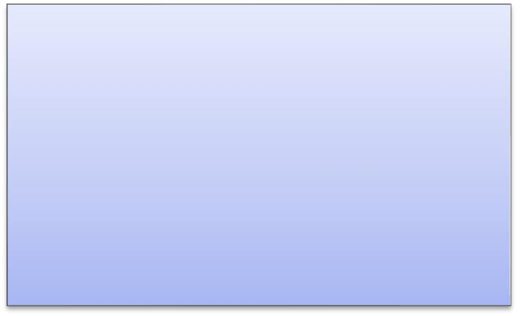
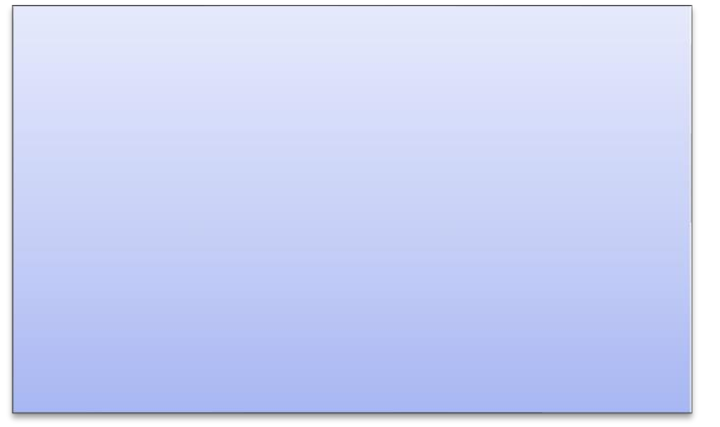
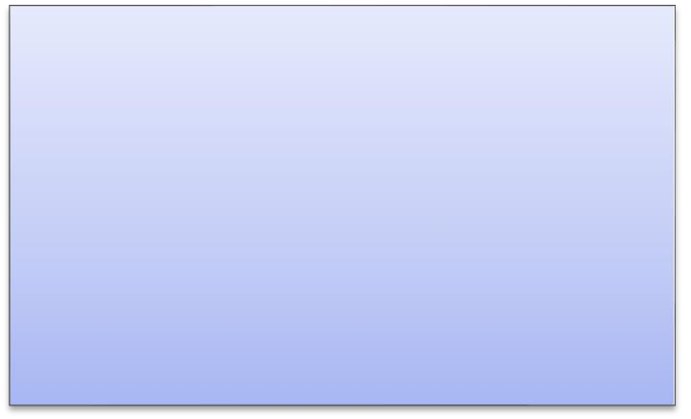
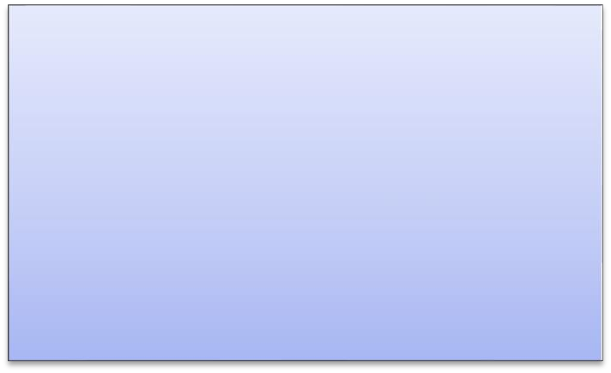
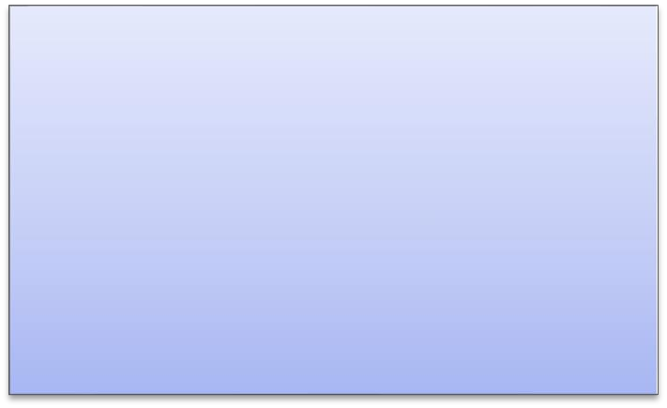
Scenario 2 – info from similar sources
6 experts, all of them are employees of XYZ working in the same division
If we combine their advice into single prediction based on voting?
Everyone has a propensity of 70% to advocate correctly.
All the predictions are based on very similar set of information
Similar predictions – accuracy will go down while voting

Slide 6
Ensemble learning
Machine learning technique that combines several base models in order to produce one optimal predictive model.
Weak classifiers
Different set of variables for each classifier
Combine into single prediction

Slide 7
What is a boot strapped dataset
Sno | X1 | X2 | Y
4 | 144 | 29 | No
2 | 529 | 34 | Yes
3 | 125 | 67 | No
Sno | X1 | X2 | Y
1 | 432 | 29 | Yes
2 | 529 | 34 | Yes
3 | 125 | 67 | No
4 | 144 | 29 | No
Random sample rows
with replacement
Sno | X1 | X2 | Y
3 | 125 | 67 | No
4 | 144 | 29 | No
4 | 144 | 29 | No
Sno | X1 | X2 | Y
3 | 125 | 67 | No
2 | 529 | 34 | Yes
3 | 125 | 67 | No

Slide 8
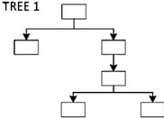
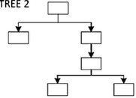
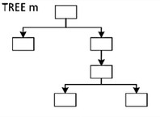
Using a random set of variables every time
Sno | X1 | X2 | Y
4 | 144 | 29 | No
2 | 529 | 34 | Yes
3 | 125 | 67 | No
Random sample rows with replacement
Sno | X1 | X2 | X3 | X4 | Y
1 | 432 | 29 | 313 | 6 | Yes
2 | 529 | 34 | 379 | 2 | Yes
3 | 125 | 67 | 317 | 4 | No
4 | 144 | 29 | 103 | 8 | No
Sno | X3 | X4 | Y
3 | 317 | 4 | No
4 | 103 | 8 | No
4 | 103 | 8 | No
Random subset of X variables
Sno | X1 | X3 | Y
3 | 125 | 317 | No
2 | 529 | 379 | Yes
3 | 125 | 317 | No

Slide 9



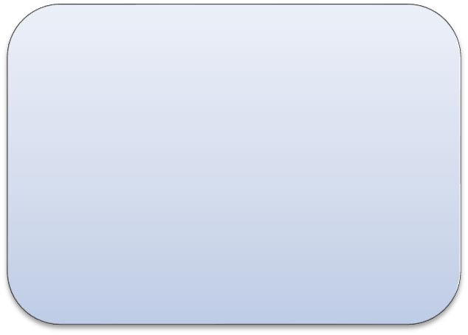
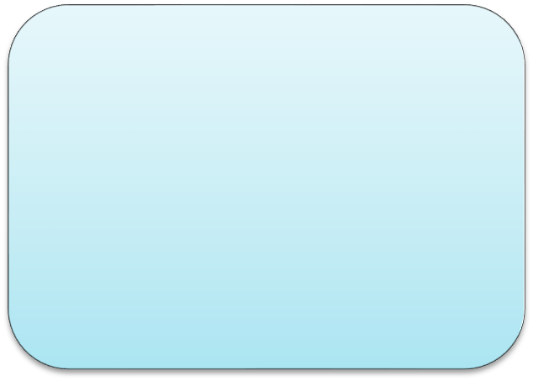
Basic idea of random forest
Draw multiple random samples, with replacement, from the data
(this sampling approach is called the bootstrap).
Using a random subset of predictors at each stage, fit a classification (or regression) tree to each sample (and thus obtain a “forest”).
Combine the predictions/classifications from the individual trees to obtain improved predictions.
Use voting for classification and averaging for prediction.

Slide 10



Steps in random forest algorithm
Step2 – create a decision tree using boot strapped dataset. But only use a random subset of variables at each step
Step1 – create a bootstrapped dataset
Step3 – repeat the same and create multiple trees

Slide 11
Out of bag data points
When we create a bootstrapped dataset, ~1/3 of the original data does not end up in the boot strapped dataset
This is called out-of-bag dataset
Sno | X1 | X2 | Y
4 | 144 | 29 | No
2 | 529 | 34 | Yes
3 | 125 | 67 | No
Sno | X1 | X2 | X3 | X4 | Y
1 | 432 | 29 | 313 | 6 | Yes
2 | 529 | 34 | 379 | 2 | Yes
3 | 125 | 67 | 317 | 4 | No
4 | 144 | 29 | 103 | 8 | No
Sno | X3 | X4 | Y
3 | 317 | 4 | No
4 | 103 | 8 | No
4 | 103 | 8 | No
Sno | X1 | X3 | Y
3 | 125 | 317 | No
2 | 529 | 379 | Yes
3 | 125 | 317 | No
11

Slide 12
How to calculate accuracy
OOB samples used to measure how accurate our random forest is
by the ratio of out of bag samples correctly classified by the random forest model
Proportion of OOB samples incorrectly classified – out of bag error
12

Slide 13
How to decide on how many variables to use per step?
Compare OOB error for using 2 variables per step, 3 variables and so on
Choose the most accurate set of variables
Typically we start by using square root of number of variables
Then try a few settings above and below the value
13

Slide 14




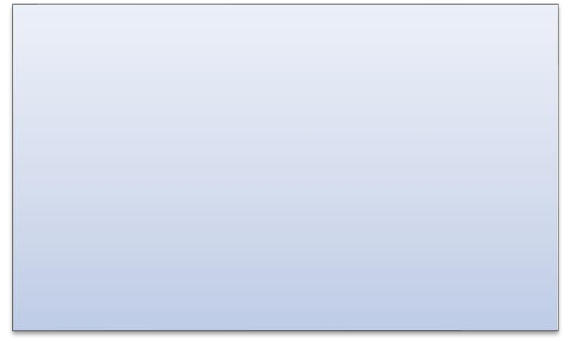
Summary of Random forest
Consists of a large number of individual decision trees that operate as an ensemble
Each tree in the random forest spits out a class prediction
class with most votes
becomes model’s prediction
A large number of relatively uncorrelated models (trees) operating as a committee will outperform any of the individual models.
fundamental concept -
wisdom of crowds
14

Slide 15


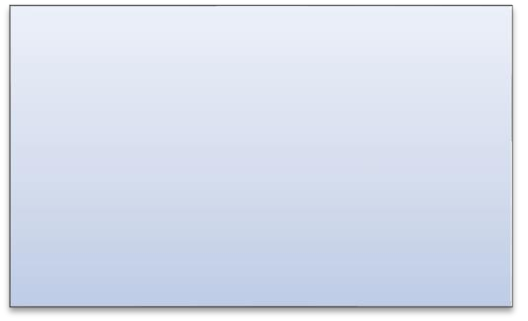




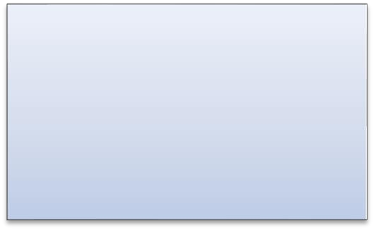



Overall flow of the RF classification process
EDA – Univariate
Boxplot for num var
Barplot for cat var
Feature engineering
– convert relevant variables to categorical
Find Baseline Y class
% to check class imbalance
Read csv file
EDA – bivariate
Boxplot – num X vs cat Y
Stacked bar – cat X vs Y
Split into training and test sets
Build a random forest model
Tune ntree & mtry
Model performance
Acc, sens, spec
AUC
Predict for train & test
Variable importance
15

Slide 16

40

